Slide 1
Some ongoing and completed cross-border projects LMI CO. Ductile Iron Pipes (DN 100-DN2000)

Slide 2
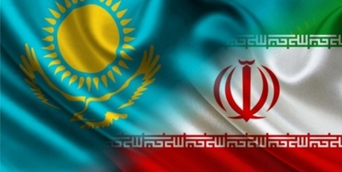
Transferring water to Nur Sultan (Kazakhstan)
Employer :
Nur Sultan water department
With Participation and investment of Russian company
Implementation year: 2022

Slide 3
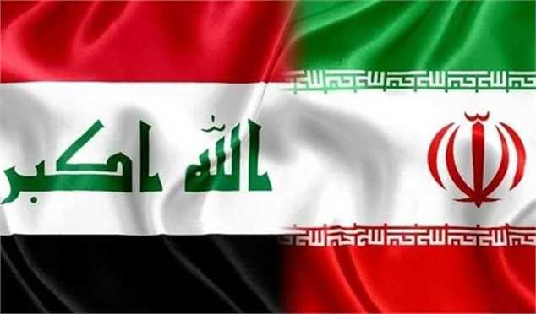
Transferring water to Basra (Iraq)
Employer:
Basra water organization and Basra governorship
Implementation year : 2022

Slide 4
Transferring water to Baghdad (Iraq)
Employer :
Baghdad water organization
Implementation year : 2022
Earthquake Resistance Pipes

Slide 5
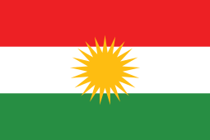
Transferring water to Erbil (Iraq)
Employer :
Erbil water organization
Implementation year : 2022

Slide 6
Transferring water to Dahouk (Iraqi Kurdistan)
Employer : Dahouk water organization
Implementation year : 2022

Slide 7
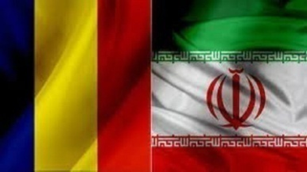
Transferring water to Bucharest city (Romania)
Employer : Bucharest water organization
Implementation year : 2022

Slide 8
Transferring water to Al Zohur residential area (Baghdad – Iraq)
Employer :
Baghdad water organization
Implementation year : 2021

Slide 9
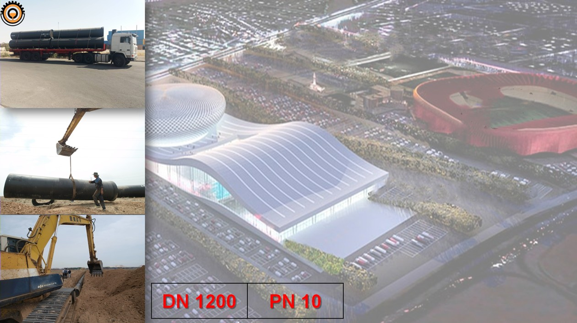
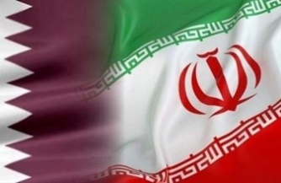
Transferring water to Al – Gharafeh (Qatar)
Employer : Al-Gharafeh water organization
Implementation year : 2021

Slide 10
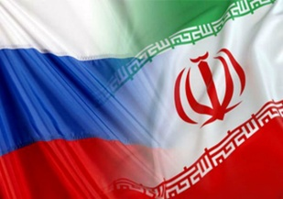
Modifying water transmission line in Moscow (Russia)
Employer : Moscow water organization
Implementation year : 2021

Slide 11
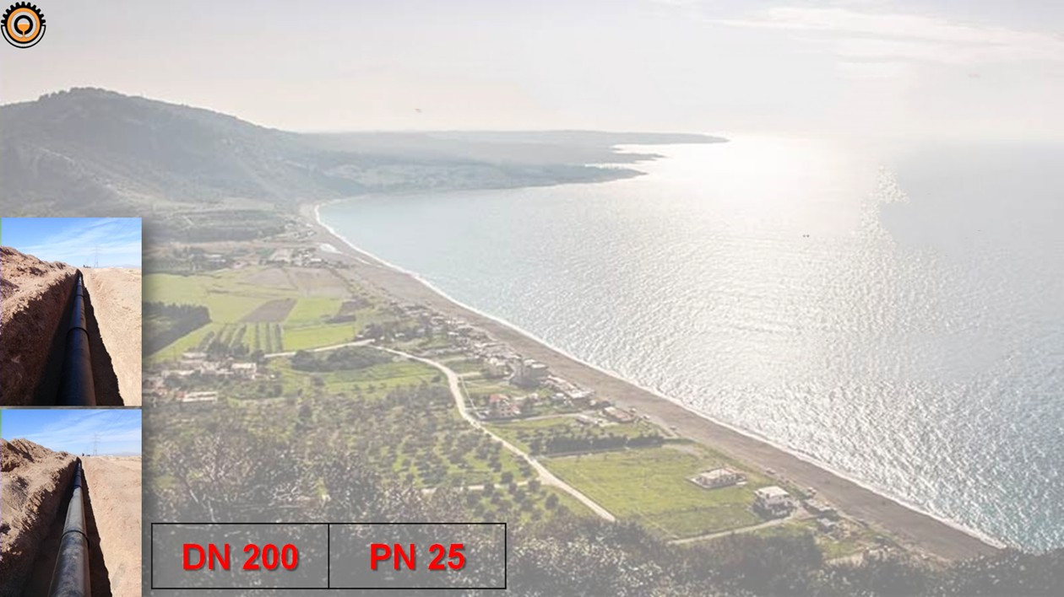
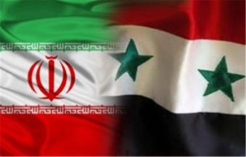
Water transmission network in Latakia (Syria)
Employer : Latakia water organization
Implementation year : 2021

